Slide 1
Event Driven Architecture
Diagrams

Slide 2
EDA Landscape
Data & Event Sources
Data , Analytics, Intelligence Services
Function Serverless Apps
Cloud Native Apps
Store
Store
Legacy App
RDBMS
IoT Sources
2
2
2
Data Sources
Store
Event Backbone
1
4
3
Mobile App
Streaming Analytics
Decision Insight
Live data/event
3
Web App
Store
Visualization /
Dashboard App
Microservice
5
Data Analysis / Learn (ML)
6

Slide 3



Why Event Driven Architecture: app today
Mobile Apps
B2B
Browsers
API Gateway
SPA
Server Pages
BFF
Shared APIs
Channel Specific APIs
Partner APIs
Backend Web APIs
Backend Processing
Notes:
Here is a traditional modern architecture with some focus on API and channels

Slide 4
Why Event Driven Architecture: app with microservice
Mobile Apps
B2B
Browsers
API Gateway
SPA
Authentication MS
User management MS
App Authorization MS
Config management MS
Asset management MS
Risk Assess MS
Notes:
Here is a traditional modern architecture with some focus on API and channels

Slide 5
Why Event Driven Architecture: Eventual Data Consistency
App Config Web
User Identity Web
User Management Web
Asset Dashboard Web
Add, delete,
update App Config
Add, delete,
update Users
Add, delete,
update Assets
APIS
APIS
APIS
APIS
APIS
Config management MS
App Authorization MS
Authentication MS
User management MS
Asset management MS
Notes:
Here is a traditional modern architecture with some focus on API and channels

Slide 6

Why Event Driven Architecture: Eventual Data Consistency
App Config Web
User Identity Web
User Management Web
Asset Dashboard Web
Add, delete,
update App Config
Add, delete,
update Users
Add, delete,
update Assets
APIS
APIS
APIS
APIS
APIS
Config management MS
App Authorization MS
Authentication MS
User management MS
Asset management MS
Messaging
Topic
Topic
Topic
Config Consumer
User Consumer
Config
Notes:
Here is a traditional modern architecture with some focus on API and channels

Slide 7

Event Sourcing
UI Web SPA
offset
Order Mgt MS
Order
USER
Order Created
Order Updated
Order Updated
Order Pending
Order Booked
Order Confirmed
Order Assigned
Order Shipped
Order In Transit
Order Delivered
Time
Immutable Ordered Events
Replay and auditability
Key OrderId

Slide 8
Event Sourcing
Order Mgt MS Pod
Order
offset
Order Created
Order Confirmed
Order Shipped
Order In Transit
Snapshot
Order Delivered
Order Created
Order Updated
Order Updated
Order Confirmed
Order Shipped
Order Mgt MS
Pod
Time
When a pod crashes, the new instance can reload from a previously committed offset, or from the last snapshot

Slide 9
Command Query Responsibility Segregation Pattern
CRUD Q APIS
Order MS
Write Model
Read Model
Projection
Events
Other subscriptions
Data

Slide 10


Command Query Responsibility Segregation Pattern
API Gateway
CRUD Q APIs
Order Service
Order Query MS
Order Query MS
Order Command MS
Order Query MS
CRUD APIs
RQ APIs
Write Model
Read Model
Data
Projection
Projection
Views
Events
orders
reefers
0
1
2
3
4
5
6
7
0
1
2
3

Slide 11
Orders Microservice: Event Sourcing & CQRS
Order Dashboard Web
Order UI Web SPA
BUSINESS
USER
END
USER
Complex Queries
Add, read by ID,
update Order
APIS
APIS
APIS
Order Command MS
Order Queries MS
BFF
orderCommands
0
1
2
3
4
5
6
7
0
1
2
3
orders
Notes:
Here is a traditional modern architecture with some focus on API and channels

Slide 12
Orders Microservice: Event Sourcing & CQRS
Order Dashboard Web
Order UI Web SPA
BUSINESS
USER
END
USER
Complex Queries
Add, read by ID,
update Order
APIS
APIS
APIS
Order Command MS
Order Command MS
BFF
Event Backbone
OrderTopic
Notes:
Here is a traditional modern architecture with some focus on API and channels

Slide 13
Order Life Cycle
Order Settlement
Order Delivery
Create Order
Order Created
Voyage found
Confirm Order
Update Order
Order Updated
Confirm Order
Order Booked
Order Completed
Allocate Voyage and
Container
Order Transit
Order Assigned
Cancel Order
Order Cancelled
Order Rejected

Slide 14
Event Sourcing Pattern
Order UI Web SPA
APIS
Order MS
Order id, addresses, customer id, product id, container id
Order specifics attributes
Status …
END
USER
Customer id
Src and dest addresses
Product id, quantity
Target delivery date
OrderEvents
OrderCreated
OrderCancelled
OrderDelivered…

Slide 15
Reefer Container - HL
UI Web SPA
Submit order
Update Order
Accept Order
Get Submitted Orders
UI Web SPA
Search Voyages
Get Pending Orders
Manuf
Shipment Inc
Orders MS
voyageEvt
Voyages
MS
Voyages
Order
Streaming Analytics
orderEvents
Containers
Problems
Event Backbone
voyages
Ships
orders
Store
Fleet / Ships
Simulator MS
Reefer Container MS
containers
Notes:
Map geographic
Multiple ships
Ship

Slide 16
Reefer Container - HL
UI Web SPA
Submit order
Update Order
Accept Order
Get Submitted Orders
UI Web SPA
Search Voyages
Get Pending Orders
Manuf
Shipment Inc
Orders MS
voyageEvt
Voyages
MS
Voyages
Order
Streaming Analytics
orderEvents
Containers
Problems
Event Backbone
voyages
Ships
orders
Store
Fleet / Ships
Simulator MS
Reefer Container MS
containers
Notes:
Map geographic
Multiple ships
Ship

Slide 17



Reefer Container - HL
Orders
Command MS
Orders
Query MS
Voyages
MS
Reefer Container MS
containers
orders
voyages
0
1
2
3
0
1
2
0
1
2
orders
voyages
containers
Notes:
Map geographic
Multiple ships
Ship

Slide 18
Command Query Responsibility Segregation Pattern
Order UI Web SPA
USER
Order Service
Order Command MS
CRUD APIs
Error Log
Write Model
Admin APIs
4
Consumer
DB
3
1
2
5
Events
Topic
0
1
2
3
4
5
6
7
CLI
6

Slide 19




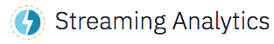

IBM Cloud Deployment
K8S-Node
Fleet-ms
1
KC-UI
K8S-Node
DEVELOPER
Orders-command-ms
voyages-ms
K8S-Node
Orders-query-ms
Containers-ms
Kubernetes Service

Slide 20
Dependency graph
User Interface
KC-UI
Fleet / Ships
Simulator MS
Order Command MS
Order Query MS
Voyages MS
Container
MS

Slide 21
Kafka Architecture
A topic
a b c d e
Consumer group
Broker-0 Server
Partition 1
Partition 2 Replica 1
Producer
Consumer
a b
Broker-1 Server
Producer
Partition 2
Partition 1 Replica 1
Consumer
a
Consumer
Partition 3
Producer
Broker-2 Server
Partition 1 Replica 2
ZooKeeper Ensemble
Node 1
Node 2
Node 3
Notes:
messages on a topic are not immediately removed after they are consumed
Each partition of a topic consists of a sequence of files called log segments. The size of the log segments is determined by the cluster configuration log.segment.bytes (default is 1 GB). This can be overridden by using the topic-level configuration segment.bytes.
Disk Space: sufficient disk space in the persistent storage for the Kafka brokers to meet your expected throughput and retention requirements
Sum (Nb messages per minutes * average size * retention time * replica factor) per topic

Slide 22
Kafka Topic / Partition/ Replicas
inTopic
Broker
Broker
Broker
Partition 0
Partition 1
Partition 2
Replicat
Primary
old new

Slide 23
High Availability: Active – (P/C) Standby
Data Center 1
Data Center 2
LB
LB
orders-topic
orders-topic
Broker 1
Broker 1
Partition 1 Replica 1
Partition 2 Replica 1
Partition 1 Replica 1
Partition 2 Replica 1
Producer
Broker 2
Partition 1 Replica 2
Partition 2 Replica 3
Consumer
Broker 2
Partition 1 Replica 2
Partition 2 Replica 3
Producer
Consumer
Broker 3
Broker 3
Partition 1 Replica 3
Partition 2 Replica 2
DB
Partition 2 Replica 2
Partition 1 Replica 3
Mirroring
Master
Slave
Notes:
One topic, 2 partitions, 3 replicas, 1 consumer group with two consumers.

Slide 24
High Availability: Active - Active
Data Center 1
Data Center 2
IBM Cloud
ICP
Dc1-orders-topic
Dc2-orders-topic
Broker 1
Broker 1
Producer
Partition 1 Replica 1
Partition 2 Replica 1
Partition 1 Replica 1
Partition 2 Replica 1
Broker 2
Producer
Broker 2
Partition 1 Replica 2
Partition 2 Replica 3
Consumer
Consumer
Partition 1 Replica 2
Partition 2 Replica 3
Consumer
Producer
Consumer
Broker 3
Broker 3
Partition 1 Replica 3
Partition 2 Replica 2
Partition 1 Replica 3
Partition 2 Replica 2
Mirroring
Mirroring
Notes:
An event added to the dc1-order-topic is consumed locally, but mirrored to the second data center

Slide 25
Solution Run Time
Worker
Worker
Worker
Worker
Worker
Worker
Master
Proxy
Master
Proxy
Calico
Calico
Calico
Master – boot Node
Proxy
k8s proxy
k8s proxy
k8s proxy
API-Server
Calico
Kafka broker-1
Kafka broker-3
Authentication
Kafka broker-2
http backend
Zookeeper-2
Calico
Nginx ingress
Zookeeper-1
Zookeeper-3
Helm repo
k8s proxy
Kafka Stream Processor
sterfs
Ubuntu
glusterfs
Ubuntu
ICP router
glusterfs
Ubuntu
Event Producer
Event Producer
Event Producer
elasticsearch
Event Consumer
icp-masters
Ubuntu
icp-proxies
Ubuntu
icp-worker1
Ubuntu
icp-worker2
Ubuntu
icp-worker3
Ubuntu
172.16.40.130
172.16.40.133*
172.16.40.136
172.16.40.137
172.16.40.138*
deployment
* The list of components is not exhaustive

Slide 26
Remote Access to Kafka Broker
Event Producer
172.16.0.0/16
32224
32224
32224
Master: 172.16.30.132
Worker: 172.16.40.137
Worker: 172.16.40.136
Worker: 172.16.40.136
Kube-proxy
API Server
Kafka broker-1
Kafka broker-2
Kafka broker-3
Proxy: 172.16.40.133
topic
topic
topic
32224

Slide 27
EDA Landscape
Data & Event Sources
Data , Analytics, Intelligence Services
Cloud Native Apps
Function Serverless Apps
Store
IoT Sources
Data Sources
Event Backbone
Mobile App
Streaming Analytics
Live data/event
Web App
Store
Dashboard App
Microservice
Data Analysis / Learn (ML)

Slide 28
Container Microservice - KStreams
Manage Container Inventory, APIs to access the inventory and consumer of ContainerEvent.
Kstreams implementation (Java – Open Liberty – JAXRS)
Container microservice as KStreams
KStream - KTable
OpenLiberty
Containers
0
1
2
3
4
5
6
7

Slide 29
Container Microservice
Containers
REST API Container Controller
Event Handler
0
1
2
3
4
5
6
7
Container Services
Event Producer
DAO
OpenLiberty

Slide 30

Legacy to Microservice
Data Transformation
SOAP API Container Controller
Container Microservice
Container Services
OpenLiberty
DAO
Containers
WebSphere
0
1
2
3
4
5
6
7
Reefers
Reefer Telemetries
Container Inventory
Change Data Capture – Agent Cluster

Slide 31
Container Microservice - KStreams
Assign container to orders
Containers
0
1
2
3
4
5
6
7
Container microservice as KStreams
KStream - KTable
containers
City-containers
Orders
Kstreams - orders
0
1
2
3
4
5
OpenLiberty

Slide 32

Container Microservice – Springboot - Postgresql
Kafka data source, web, kafka template.
Containers
0
1
2
3
4
5
6
7
Container microservice Springboot
containers
Consumer - containers
City-containers
Orders
Consumer - orders
0
1
2
3
4
5
Tomcat

Slide 33
Container Microservice – Springboot - Postgresql
4
3
Producer
Consumer
2
psql
Containers
0
1
2
3
4
5
6
7
1
Container microservice Springboot
containers
Consumer - containers
Producer
Producer
6
City-containers
Orders
Consumer - orders
Producer
0
1
2
3
4
5
6
Tomcat
Consumer
5

Slide 34

Container Microservice - Python
Manage Container Inventory, APIs to access the inventory and consumer of ContainerEvent.
Python Flask, Kafka python API
Container microservice
Kafka Consumer
Python Flask
Containers
0
1
2
3
4
5
6
7

Slide 35

Order Simple Producer - Python
Python Flask, Kafka python API
Order Producer
Kafka Producer
orders
Python Flask
0
1
2
3
4
5
6
7
3
Topic Consumer
1
2
Notes:
What to consider:
-

Slide 36
Event Sourcing Integration Test Env
Order Events Producer
orders
0
1
2
3
4
5
6
7
Topic Consumer

Slide 37

Local Environment – docker compose
Docker compose kc-solution
Docker network
Docker compose backbone
UI
FleetMS
ZooKeeper
Order Command MS
Postgresql
Order Query MS
Voyage MS
Container MS
containers

Slide 38
Event Stream As Event Store for ML
Python
ML Environment
Simulator
Pandas DF
Container metrics

Slide 39
Event Stream As Event Store for ML
Python
ML Environment
Kafka Consumer
Simulator
Pandas DF
0
1
2
3
4
5
Container Inventory
containerMetrics

Slide 40

MQ- Event Stream
Kafka Connect worker
MQ Broker
SOAP API Container Controller
Liberty
To-container
Reefer
Container MS
MQ Source Connector
Container Services
JMS Producer / Listener
Kafka Connect worker
DAO
MQ Sink Connector
From-container
WebSphere AppServer
DB2 Container Inventory
0
1
2
3
4
5
containers

Slide 41
Data Replication: Orders table to kafka
1 table to 1 topic mapping
Topic acts as a transaction log
DB operations are implemented by record writes to a Kafka topic
Legacy runtime
RDBMS
Orders
Orders
0
1
2
3
4
5
6
(24, (24, “abc”)),
[ primary_key, values]
Cloud native runtime clusters
source
(key,values)
sink
RDBMS
Notes:
Representing DB2 table to distinct Kafka topic
A unique row in a DB2 table is represented by the Kafka record’s “Key”
The “Kafka Key” is comprised of a subset of the columns in the DB2 table which make the row unique
The “Kafka Key” is comprised of a subset of the columns in the DB2 table which make the row unique
Could be a unique index or the primary index defined on the DB2 table
Also possible for the rows to logically be unique, needn’t be a created index
The Kafka record’s “Value” contains the current values for all columns in the row
The messages in a topic represent the changes to the rows of a table over time
At any given sample offset in the topic, taking the most recent value up to that point for each unique key in the topic gives the original DB2 table at that point
Sample offset most useful if at a transaction boundary
For table orders ( orderID int, anAttribute varchar (30))
A Kafka mapping might use orderID=24 as the key value.
The Topic for orders (Topic_orders) might consist of the following (key,value) pairs: (24, (24, “abc”)), (25,(25, “def”)), (24, (24, “ghi”))
The aggregate result of these records would be a table with 2 rows: (24, “ghi”), (25, “def”)
Operations are implemented by record writes to a Kafka topic
Deletes
•Kafka represents a delete as a record with a key and null for the value.
•To represent a delete of the row with i1 value 1, send the (key, value) pair (1, null)
•New users often confused when they view values and simply see null.
•Displaying the key portion of the record is useful. (print.key=true)
Updates
•If the value being updated is not part of the key, an update is simply an insert.
•To represent a row update of (1, “abc”) to (1, “ghi) send the (key, value) pair (1,(1, “ghi”))
•If the value being updated is a key, it is represented by a delete record and an insert record.
•To represent the update of row (1, “abc”) to (5, “abc”) send two (key, value) pair records (1, null) , (5, (5,“abc”))

Slide 42
IBM DR Architecture
Legacy runtime
Business App
Replication Solution
RDBMS
Management console
RDBMS
Server
Server
doc
Orders
Capture Agent
messaging
Apply / Transform Agent
[ primary_key, values]
logs
Network
Data lake
Store procedure

Slide 43

IIDR Architecture on k8s? (N/A)
Legacy runtime
IIDR management console
Business App
Worker Node
RDBMS
Worker Node
Server
Worker Node
Worker Node
RDBMS
Kubelet
Kubelet
doc
IIDR Capture Agent
Orders
IIDR Kafka Agent
Kafka Schema Registry
orders
[ primary_key, values]
Kafka
Kafka Connect Sink
Data lake
logs
PV - metadata
Zookeeper
Store procedure

Slide 44
IIDR Architecture on k8s? (N/A)
IIDR management console
Legacy runtime
Business App
Worker Node
Worker Node
Worker Node
Worker Node
Worker Node
RDBMS
Kubelet
Kubelet
Kubelet
Orders
Kafka Connect Sink
IIDR Capture Agent
[ primary_key, values]
Kafka
Kafka Schema Registry
RDBMS
logs
IIDR Kafka Agent
Zookeeper
Store procedure
PV - metadata

Slide 45
Schema Registry
Reefer Container Events Producer
Schema Cache
Schema ID +
message
Schema ID +
message
Schema ID
register
schema
0
1
2
3
4
5
Reefer Container Mng Service (Consumer)
containers
Schema Cache
Avro Schema
Schema Registry
Avro Schema
Get schema(ID)
https://ibm-cloud-architecture.github.io/refarch-kc/avro/avro/

Slide 46
Shipping Order Management Service

Slide 47
Problem statement
How do you model the reefer shipment domain?
Manufacturer
Place Shipment Order
Fresh Cargo Shipment Order Placed
Order business conditions and SLA
Received
Confirm Order
Shipping Inc Clerk
Define contract conditions and SLA
New
shipment order created
Voyage for shipment
selected
Container Assigned
Order Confirmed accepting business conditions and SLA
Whenever shipment order placed, reserve voyage and container
Whenever shipment order placed, trigger adjust confirmation penalty clauses

Slide 48
Weather
forecast system
Customer Relationship
system
container-shipping Domain
Reefer Container
subdomain (core)
Shipping subdomain (core)
Order subdomain (support)
Voyage subdomain (core)
Contract subdomain (support)
Inventory subdomain (support)
Fleet monitoring
system
Invoice
system
Notes:
Core Domain
Core business, this is where your organization is earning its money
High degree of differentiation to competitors
Development: Inhouse with your best teams
Supporting Subdomain:
Supporting functionality, that is not available as COTS-Software
Can be implemented with external support but inhouse teams should be in the lead
Generic Subdomain:
Suitable for Outsourcing, COTS

Slide 49
Weather
forecast system
Customer Relationship
system
container-shipping Domain
Reefer Container
subdomain (core)
Shipping subdomain (core)
Order subdomain (support)
Voyage subdomain (core)
Contract subdomain (support)
Inventory subdomain (support)
Fleet monitoring
system
Invoice
system
Notes:
Core Domain
Core business, this is where your organization is earning its money
High degree of differentiation to competitors
Development: Inhouse with your best teams
Supporting Subdomain:
Supporting functionality, that is not available as COTS-Software
Can be implemented with external support but inhouse teams should be in the lead
Generic Subdomain:
Suitable for Outsourcing, COTS

Slide 50
Entities – Value Objects
Shipping Order
orderID
Emitter customerID
Receiver customer ID
*
Delivery History
*
Delivery Specifications
Good Type
Expected Temperature
Tracking Number
Origin Address
Destination Address
Expected PickUp Date

Slide 51
Shipping Order
orderID
*
Delivery History
role
Customer
name
customerID
*
Delivery Specifications
Good Type
Expected Temperature
Tracking Number
Origin Address
Destination Address
Expected PickUp Date
Reefer Container
containerID
type
Reefer Telemetry
containerID
Power
Temperature
Co2
O2
Location
Port Code
To
*
Voyage
voyageID
schedule
To
From
Vessel Movement
voyageID
Vessel name
Leg
Departure Date
Expected Arrival Date
From
*
Inspired from Eric Evans‘s shipping domain

Slide 52
Root aggregate
Shipping Order
orderID
*
Delivery History
role
Root aggregate
Customer
name
customerID
*
Delivery Specifications
Good Type
Expected Temperature
Tracking Number
Origin Address
Destination Address
Expected PickUp Date
Reefer Container
containerID
type
Root aggregate
Reefer Telemetry
containerID
Power
Temperature
Co2
O2
Location
Port Code
To
*
Voyage
voyageID
schedule
To
From
Vessel Movement
voyageID
Vessel name
Leg
Departure Date
Expected Arrival Date
From
*

Slide 53
Root aggregate
Shipping Order
orderID
*
Delivery History
*
Delivery Specifications
Good Type
Expected Temperature
Tracking Number
Origin Address
Destination Address
Expected PickUp Date

Slide 54
Manufacturing Submitting and updating orders
Manuf UI BFF
Order Command MS
Order Query MS
Whenever 0rder is in ”noAvailability” state,
user can expand the transport window.
This will trigger a new (automated) voyage booking .
saveOrder
orders
Create
Order Evt
{orderID…}
0
1
2
Order Created
Order
orders
Order
Created
0
1
2
3
Order
Query
Views
Explanation:
If a manufacturers order request asked for a delivery window for which there is no voyage available
the order will be in “no Availability” state
Manufacture is allowed to update order with new dates or addresses
this will trigger new (automated) voyage selection
Above approach will save us from writing logic to
Determine if previous booking
Cancel it
New booking
Possible race conditions

Slide 55
Manufacturing Submitting and updating orders
Manuf UI BFF
Order Command MS
Order Query MS
Better ( more easily demoable policy) :
Whenever 0rder is in ”noAvailability” state,
user can expand the transport window
This will trigger a new ( (automated) voyage booking .
saveOrder
orders
Create
Order Evt
{orderID…}
0
1
2
Order Created
Order
orders
Order
Created
0
1
2
3
Order
Query
Views
Explanation:
If a manufacturers order request asked for a delivery window for which there is no voyage available
the order will be in “no Availability” state
Manufacture is allowed to update order with new dates or addresses
this will trigger new (automated) voyage selection
Above approach will save us from writing logic to
Determine if previous booking
Cancel it
New booking
Possible race conditions
getCreatedOrders
updateOrder
orders
0
1
2
3
Order
Query
Views
Order

Slide 56
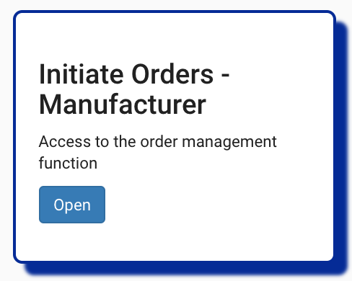
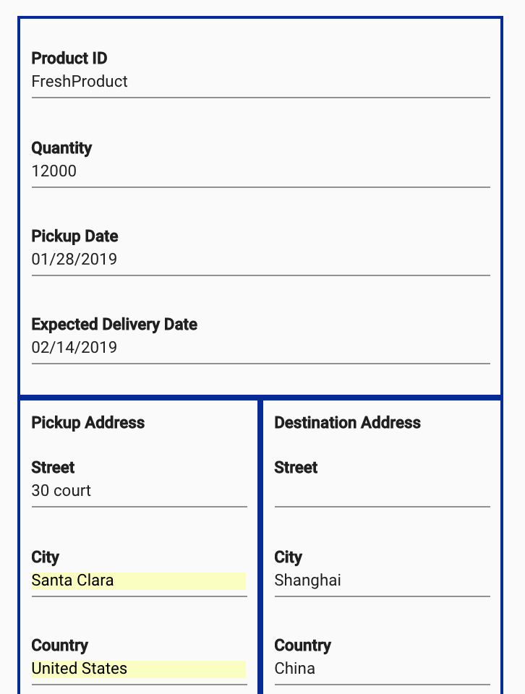
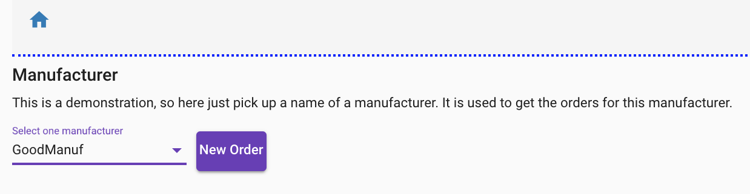
Manufacturing Creating Order

Slide 57
Manufacturer
Whenever shipment order received, update future availability and reserve space
Whenever shipment order placed, schedule and notify source transport
Land Transport Broker Scheduling System
Shipping Inc
Land Transport Inc
Place Shipment Order
Whenever shipment order placed, adjust confirmation penalty clauses
Order Shipping Preparation
Process Land Transportation Order
Shipment Order Placed
Shipment Order Pending
Voyage Found for Expected Container
Order Booked
Container Routing and placement established
Source Land Transport booked
Pickup time confirmed to manufacturer
Ship Voyage Scheduling System
Whenever transport is booked confirm to manufacturer
Continue…

Slide 58
Shipment Order Placed
Order Confirmed accepting business conditions and SLA
Place Shipment Order
Shipment Order
Shipment Order Pending
Order:
estimate delivery data
Destination
Pickup date
Product ID
quantiry
Appropriate Container type ordered
Voyage Found for Expected Container
Order Booked
Product Shipped
Container Routing and placement established

Slide 59

Order MS
order-command-ms
Create
OrderCreated
Topic orders
validation
Update
OrderUpdated
validation
GetAll
OrderCreated
OrderUpdated
OrderAssigned
Partition 0
GetById
order-query-ms
OrderCreated
OrderUpdated
OrderAssigned
GetByManuf
GetAllPending

Slide 60
order-command-ms Create Order: POST to /
Body:
{
"productID":"myProductID",
"quantity":101,
"customerID": "GoodManuf",
"expectedDeliveryDate":"2019-01-10T13:30Z",
"pickupDate":"2019-01-10T13:30Z",
"pickupAddress": {"street": "200 1st street", "city": "Shanghai", "country": "China", "state": "", "zipcode": "09430"},
"destinationAddress": {"street": "500 main street", "city": "San Leonardo", "country": "USA", "state": "CA", "zipcode": "95030"}
}
Response:
{
"orderID":"dfd79376-c46e-41c4-aa88-08a3594fe2f8",
"productID":"myProductID",
"customerID":"GoodManuf",
"quantity":101,
“status”: “Created”,
"pickupAddress":{"street":"200 1st street","city":"Shanghai","country":"China","state":"","zipcode":"09430"},
"pickupDate":"2019-01-10T13:30Z",
"destinationAddress":{"street":"500 main street","city":"San Leonardo","country":"USA","state":"CA","zipcode":"95030"},
"expectedDeliveryDate":"2019-01-10T13:30Z”
}
Order:
estimate delivery data
Destination and pickup adresses
Pickup date
Product ID
quantiry

Slide 61
order-command-ms Update Order : PUT to /{orderID}
Body:
{
"orderID": "dfd79376-c46e-41c4-aa88-08a3594fe2f8",
"productID":"myProductID",
"quantity":101,
"customerID": "GoodManuf",
“status”: “Created”,
"expectedDeliveryDate":"2020-01-10T13:30Z",
"pickupDate":"2020-01-10T13:30Z",
"pickupAddress": {"street": "100 2nd street", "city": "Shanghai", "country": "China", "state": "", "zipcode": "09430"},
"destinationAddress": {"street": "200 other street", "city": "San Leonardo", "country": "USA", "state": "CA", "zipcode": "95030"}
}
Response:
{
"orderID":"dfd79376-c46e-41c4-aa88-08a3594fe2f8",
"productID":"myProductID",
"customerID":"GoodManuf",
"quantity":101,
“status”: “Created”,
"pickupAddress":{"street":"100 2nd street","city":"Shanghai","country":"China","state":"","zipcode":"09430"},
"pickupDate":"2020-01-10T13:30Z",
"destinationAddress":{"street":"200 other street","city":"San Leonardo","country":"USA","state":"CA","zipcode":"95030"},
"expectedDeliveryDate":"2020-01-10T13:30Z”
}
Order:
estimate delivery data
Destination and pickup adresses
Pickup date
Product ID
quantiry

Slide 62
Manufacturing Get list of orders
Manuf UI BFF
Order Command MS
Order Query MS
getOrdersByManuf
orders
Order
Query
Views

Slide 63
order-query-ms Get by manufacturer: GET to /byManuf/{ManufID}
Get all pending: GET to /pending/
Same schema, just different filter
Response:
[{
"orderID":"dfd79376-c46e-41c4-aa88-08a3594fe2f8",
"productID":"myProductID",
"customerID":"GoodManuf",
"quantity":101,
“status”: “Created”,
"pickupAddress":{"street":"100 2nd street","city":"Shanghai","country":"China","state":"","zipcode":"09430"},
"pickupDate":"2020-01-10T13:30Z",
"destinationAddress":{"street":"200 other street","city":"San Leonardo","country":"USA","state":"CA","zipcode":"95030"},
"expectedDeliveryDate":"2020-01-10T13:30Z”
},
{….},
]
Whenever the status of the order is not completed ?

Slide 64
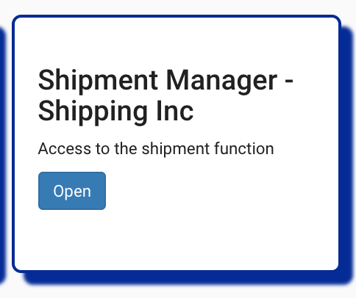
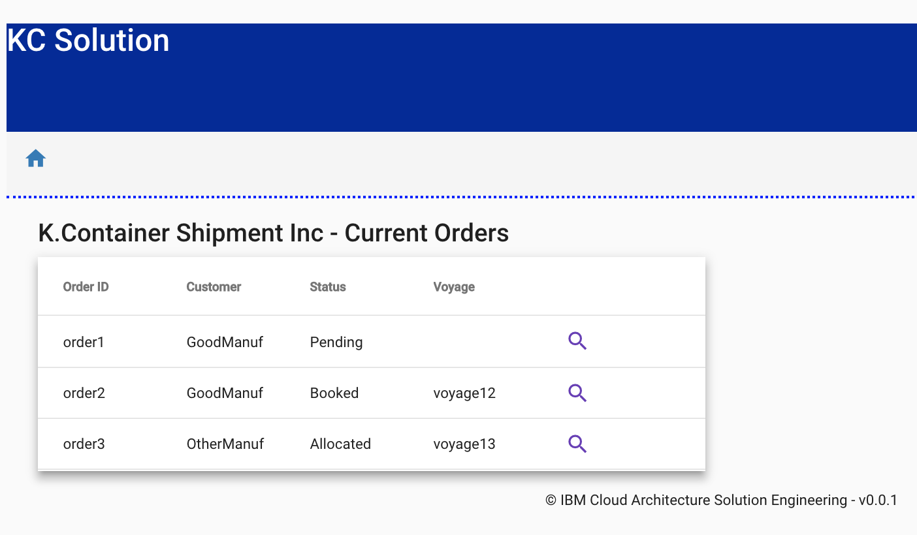
K Container Shipment Inc – Order management

Slide 65
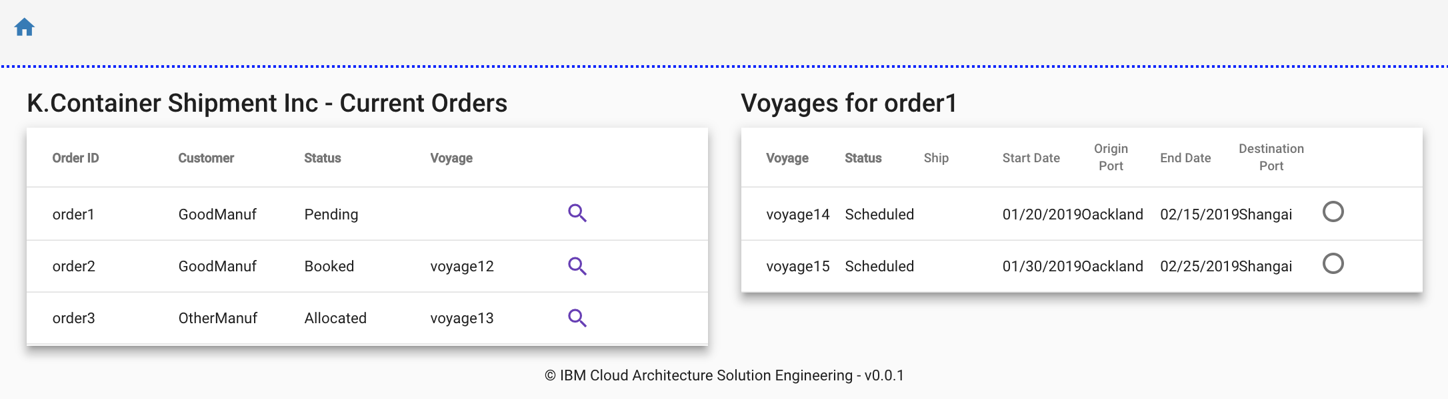
K Container Shipment Inc – Order management

Slide 66
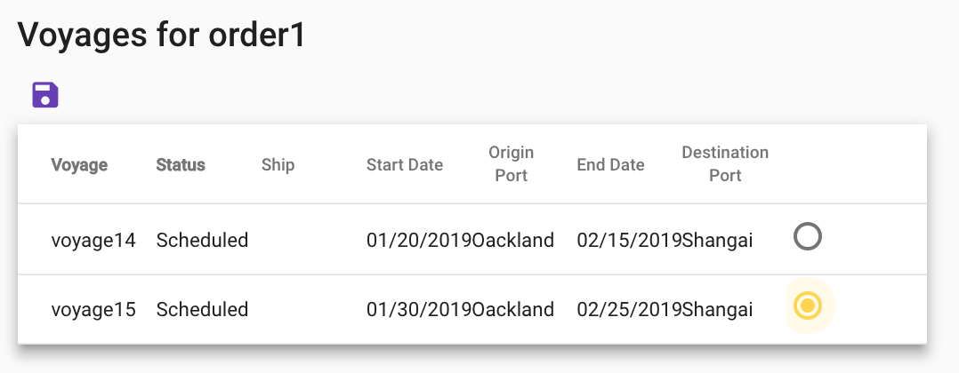
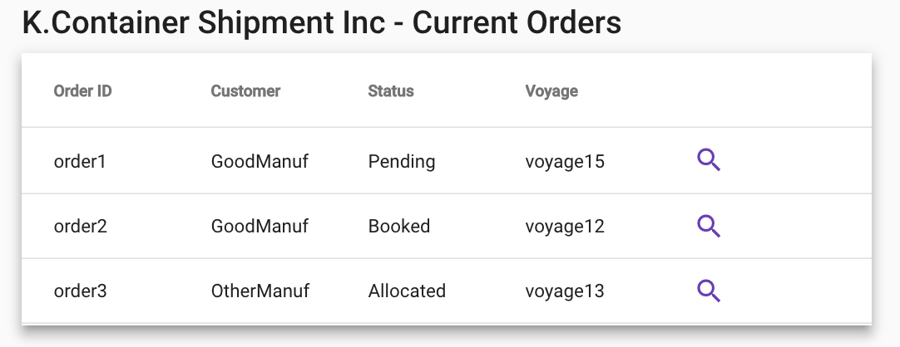
K Container Shipment Inc – Order management
Select one of the possible voyage
Save is going to the backend

Slide 67
Shipment Inc – Manual voyage assignment
Shipment UI BFF
Order Command MS
Order Query MS
Voyage Command MS
Container Command MS
getCreatedOrders
Order
Query
Views
searchVoyage
voyages
Order
0
1
2
3
Voyages
Order Pending
voyageBooked
orders
{orderID, voyageID, shipID…}
0
1
2
3
Order
Query
Views
Order Booked
Order
allocateContainer
Order Allocated to Container

Slide 68
Shipment Inc – Automatic best voyage
Manuf UI BFF
Order Command MS
Voyage Command MS
Container Command MS
Order Query MS
saveOrder
orders
Create
Order Evt
{orderID…}
0
1
2
Order
orders
Order Pending
Order
Created
0
1
2
3
Voyages
voyageBooked
orders
0
1
2
3
4
Order Booked
Order
orders
0
1
2
3
4
5
6
Order Allocated to Container
{orderID, voyageID, shipID…}
Order
Query
Views
Order

Slide 69
order-query-ms
Topic orders
GetByManuf
OrderCreated
OrderUpdated
OrderAssigned
GetById
GetAllPending

Slide 70
Assigning an order to a voyage
The UI displays pending orders 3) and available voyages 4). A operator or external process does the matching
User Interface
1) New order
3) Get pending orders
4) Get voyages
5) Assign order to voyage
Order-command-ms
Order-query-ms
Voyages-ms
2) OrderCreated
2) OrderCreated
6) OrderAssigned
6’) OrderDenied
6) OrderAssigned
6’) OrderDenied
6) OrderAssigned
6’) OrderDenied
Topic orders

Slide 71
order-command-ms Get all orders: GET to /
Response:
[{
"orderID":"dfd79376-c46e-41c4-aa88-08a3594fe2f8",
"productID":"myProductID",
"customerID":"GoodManuf",
"quantity":101,
“status”: “Created”,
"pickupAddress":{"street":"100 2nd street","city":"Shanghai","country":"China","state":"","zipcode":"09430"},
"pickupDate":"2020-01-10T13:30Z",
"destinationAddress":{"street":"200 other street","city":"San Leonardo","country":"USA","state":"CA","zipcode":"95030"},
"expectedDeliveryDate":"2020-01-10T13:30Z”
}]

Slide 72
Voyages Management Service

Slide 73
voyages-ms Assign order to voyage: POST to /{voyageID}/assign
Body:
{
"orderID": " dfd79376-c46e-41c4-aa88-08a3594fe2f8 ",
"containers": 2
}
Response: TBD

Slide 74
voyages-ms
Get all: GET to /
Response:
[
{"voyageID":"100", "shipID":"ship1", "srcPort":"NYC", "plannedDeparture":"2019-02-01T20:20Z", "destPort":"LON", "plannedArrival":"2019-02-10T20:20Z"},
{"voyageID":"200", "shipID":"ship2", "srcPort":"NYC", "plannedDeparture":"2019-02-01T20:20Z", "destPort":"LON", "plannedArrival":"2019-02-10T20:20Z"},
{"voyageID":"300", "shipID":"ship3", "srcPort":"NYC", "plannedDeparture":"2019-02-01T20:20Z", "destPort":"LON", "plannedArrival":"2019-02-10T20:20Z"}
]
Should include remaining free slots
Also include current voyage status ? Waiting, in transit, completed?

Slide 75
voyages-ms
Get by ID: GET to /{voyageID}
Response:
{"voyageID":"100", "shipID":"ship1", "srcPort":"NYC", "plannedDeparture":"2019-02-01T20:20Z", "destPort":"LON", "plannedArrival":"2019-02-10T20:20Z"},
Should include remaining free slots
Also include current status ? Waiting, in transit, completed?

Slide 76
voyages-ms
OrderAssigned
Assign
Topic orders
GetAll
OrderAssigned
GetById

Slide 77
K Containers example - Event Bus Topics
Topic | EventType | Event Data | Emitter | Users
Orders | newOrder | pickupFrom, deliverTo, pickupAfter, deliverBy,refid | OrdersMS | OrdersMS, OrdersQ
 | bookedVoyage | OrderID, Voyage, Ship, Dates, refid | VoyagesMS | OrdersMS , OrdersQ
 | noAvailability | OrderId, refid | VoyagesMS | OrdersMS, OrdersQ
 | allocatedContainer | OrderId, container ID | ContainersMS | OrdersMS, OrdersQ
 | ContainerOnShip | ContainerId, OrderId, VoyageId | VoyagesMS | OrdersMS, OrdersQ
Containers | needEmpty | OrderId, atPort, date, | OrdersMS | ContainersMS
Voyages | FullContainerReady | OrderId,ContainerId,VoyageId | OrdersMS | Voyages MS , ShipsSim, OrdersQ
 | ShipStartedVoyage | ShipId, VoyageId , manifest{<Orderid,ContainerId>} | ShipsMS | VoyagesMS
Ships | ShipPosition | ShipId, | ShipsMS | OrdersQ, ShipsQ
Containers | ContainerTemp+GPS | ContainerId, temp, position | ContainersStreams | OrdersQ, ContainersQ
 | ContainerAction | ContainerId, Action | ContainersStreams | OrdersQ, ContainersQ
 | ContainerTempError | ContainerId, FailCode | ContainersStreams | OrdersQ, ContainersQ
Voyages | ShipEndedVoyage | ShipId, VoyageId | ShipsSim | VoyagesMS, OrdersQ
Orders | ContainerOffShip | ContainerId, OrderId | VoyagesMS | OrdersMS, OrdersQ
 | ContainerDelivered | ContainerId, OrderId | OrdersMS | OrdersMS, OrdersQ
Containers | containerReleased | ContainerId | OrdersMS | ContainersMS
Orders | OrderCompleted | OrderId | OrdersMS | OrdersMS, OrdersQ

Slide 78
Container Management Service

Slide 79
Event Storming - Container
Container added to inventory
Container landed at location
Container on vessel
Container off vessel
Container on truck
Container off truck
Container removed from inventory
Container assigned to order
Container released from order
Container loaded
Container unloaded
Container in maintenance
Container off maintenance
Container door closed
Container door opened
Continue…

Slide 80
Shipping Oinc Clerk
Add Reefer Container to inventory
Container added to inventory
Whenever shipment order is created, reserve container
Whenever shipment order delivered, release container
Remove Reefer Container inventory
Container removed from inventory
Assign Container to order
Release Container from order
Set Reefer Container in maintenance
Container in maintenance
Container assigned to order
Container released from order
Release Reefer Container from maintenance
Container off maintenance
1
2
3

Slide 81
Container Bounded Context
Container on truck
Container on vessel
Container off truck
Container off vessel
Add Container to inventory
Container added to inventory
Container removed from inventory
Container loaded
Container:
Type
Location
Capacity
Brand
Status
Container landed at location
Assign Container to order
Container unloaded
Container assigned to order
Release Container to order
Container released from order
Container door closed
Container in maintenance
Container door opened
Remove Container from inventory
Container out maintenance

Slide 82
OLD Container - HL
UI Web SPA
USER
Fleet / Ships
Simulator MS
Container
MS
Order Mgt MS
Voyages MS
Ship
fleet
ReeFer
Order
voyages
Voyages
Event Backbone
ship
container
orders
Problems
Store
Streaming Analytics
Customs
Simulator
Redis
aggregates
Port Load/Unload
Simulator
Land Transportation
Mgt MS
Import
Export docs
Order
Containers Mules
Farms
Notes:
Map geographic
Multiple ships
Ship

